Slide 1
Cognitive Fitness:
Towards Conditioning the Mental Ingredients of Peak Performance
Dr Eugene Aidman, FAPS
Principal Scientist, DSTG
March 2021
Notes:
Hello everyone – and congratulations to conference organisers for putting together such a diverse program, stimulating new ways of tackling what matters on the ground to our end-user communities, My background is in neuropsychology and psychometrics. I am leading a research program on cognitive performance at DST group. In particular, I am interested in fitness, in all its forms. I spent my PhD years measuring Vo2max and lactate thresholds. I am also wondering if we could have similar fitness metrics for cognitive strength, endurance and agility? Better still – if we could train them in a Cog Gym-type setting in addition to knowledge and skill acquisition? Turns out we can – or at least we can start unpacking the promising metafor of mental and cognitive fitness into measurable and biologically traceable elements. Modern neuroscience is a game-changer here – it drives a rapid accumulation of evidence about the inner workings of the body and the brain, and converting this evidence into usable technologies has become realistic.
My PhD actually focused on measuring mental effort, from schoolkids to Olympians, and taught me not only that those measurements were linked to physical health and fitness, like VO2max and AnThreshold, but that excess mental effort could lead to adverse outcomes such as overtraining and injuries. As a postdoc in sport psych, with suicidal Olympians in my caseload, I was forced to add the space between the ears to my fitness programming as I scrambled for answers to how to avoid conceding health and even lives in the service of un-balanced ambition.
As a post-doc in the early 90-s I was privileged to work with one of the legends and pioneers of neuroscience in psychology – the product of that collaboration at Brain Bh Res Inst was this little booklet - Jogging the Brain (1996) LaTrobe Uni Press, with a subtitle “Mental Fitness Kit” and pull-out exercise sheets like these attention tables modelled on those I saw in the cosmonaut training program during my doctorate. Fast forward 20 years – and my work at DST is now focused on soldier performance, from selecting the fittest to developing training and operational support tools. Comparing it to my work as a sport psychologist made me realise that what it takes to sustain performance under pressure is remarkably common across many occupations, from firefighters and emergency crews, to acute medicine, sport, performing arts and the military. The Cognitive Fitness Framework (CF2) was developed to assemble the key drivers of cognitive performance across these multiple domains.

Slide 2
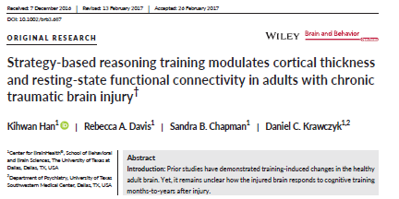
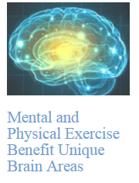
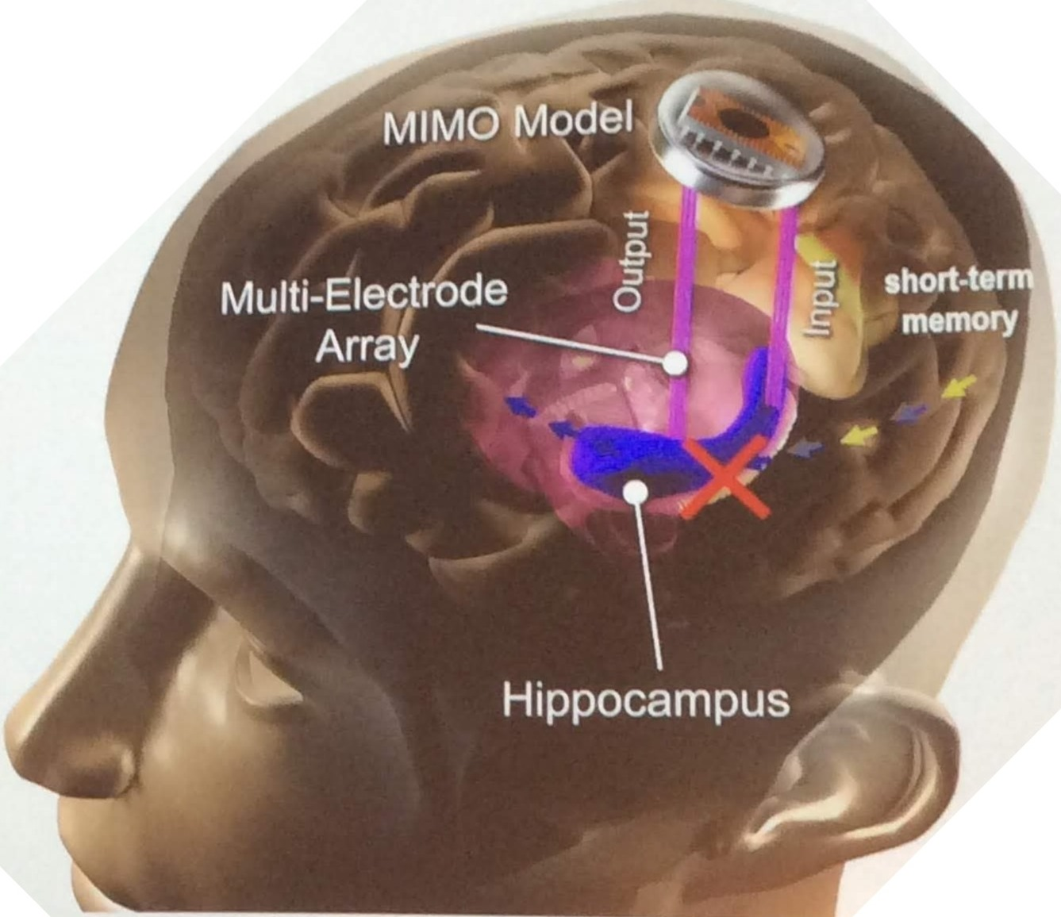
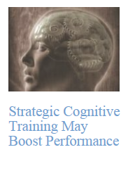
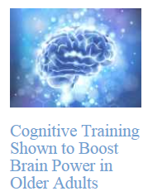
Notes:
On the other hand – the art of the possible. Translational Neuroscience is developing at an astonishing pace, offering solid evidence for Interventions that would have been considered science fiction just a few years ago. From cleverly designed reasoning strategy training that improves the thickness of brain cortex in patients with TrBrIn, to Transcranial stimulation capable of erasing unwanted memory traces, and even Brain implants (Hyppocampal prothesis) to replace the neural circuit that decodes Short-Term Memory to Long-Term Memory and underpins all new learning, currently good to compensate memory deficits but aiming for memory-booster functionality (DARPA-funded). And in between –

Slide 3

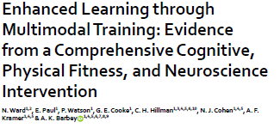
Notes:
a myriad of methods informed by Neuroscience and getting increasingly more realistic for practical applications (e.g., not relynig on rolling out lab-grade equipement (e.g., A.Luria – first perofmrance-based neuropsych tests during WW2). These include on-screen cogntive tasks with and without transcranial stimulation, as illustrated by this Randomised Trial.

Slide 4
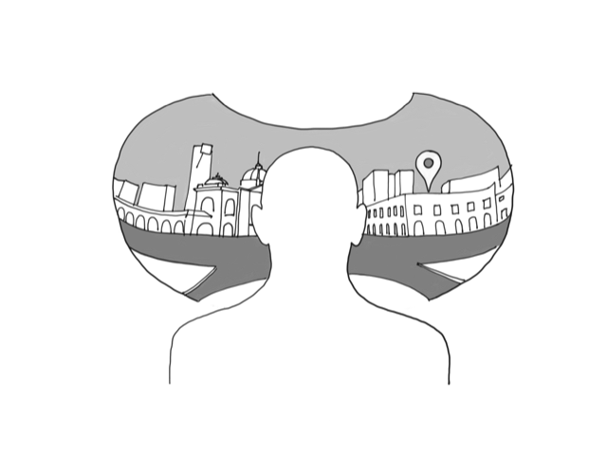
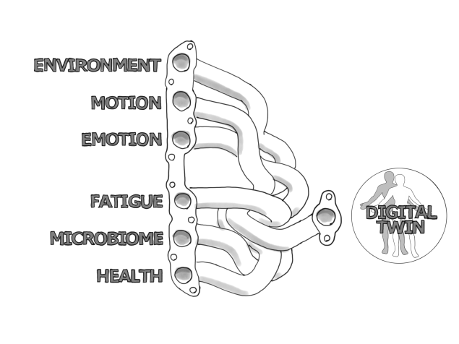
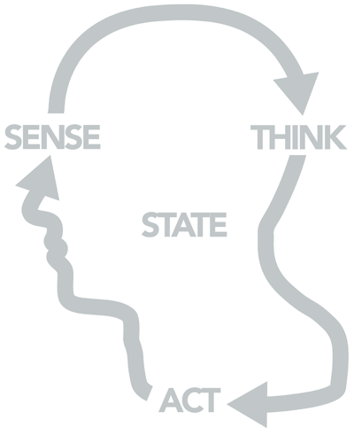
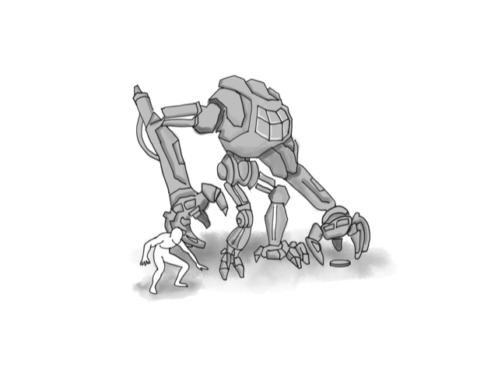
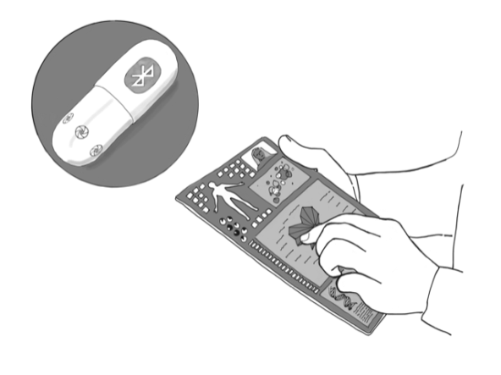
Enhancement & Augmentation
Opportunities
Notes:
It’s worth noting here that Enhancement is not same as Augmentation, and it is no longer limited to “natural” methods of enhancing ourselves through learning a new skill or using the tools such as a hammer or binoculars. We can augment our sensing and perception with radars and NVGs and enhance it through corrective eye surgery (as Tiger Woods did, wonder what the WADA had to say about that one). We can enhance our thinking through education or training and augment it through decision support tools for tactical decisions, and expert consensus building techniques, like the Delphi, for more strategic tasks. We can enhance our action capacity through strength and conditioning, and augment it with exoskeletons, robotic mules or compression garments. We can enhance our functional state through nutrition, work-rest hygiene or mental skills training and augment it with caffeine and other fatigue countermeasures. The end result is the same – enhanced performance. In the field of cognitive enhancement the distinction is typically between cognitive fitness and the tools that can amplify its impact on your performance. So, what are the key elements of cognitive performance we are focused on?

Slide 5
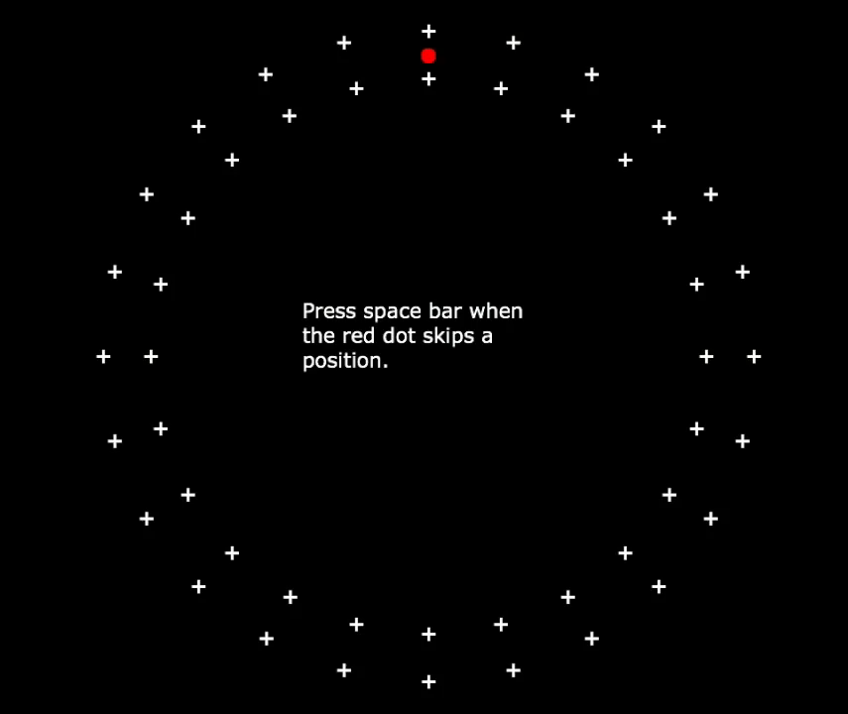
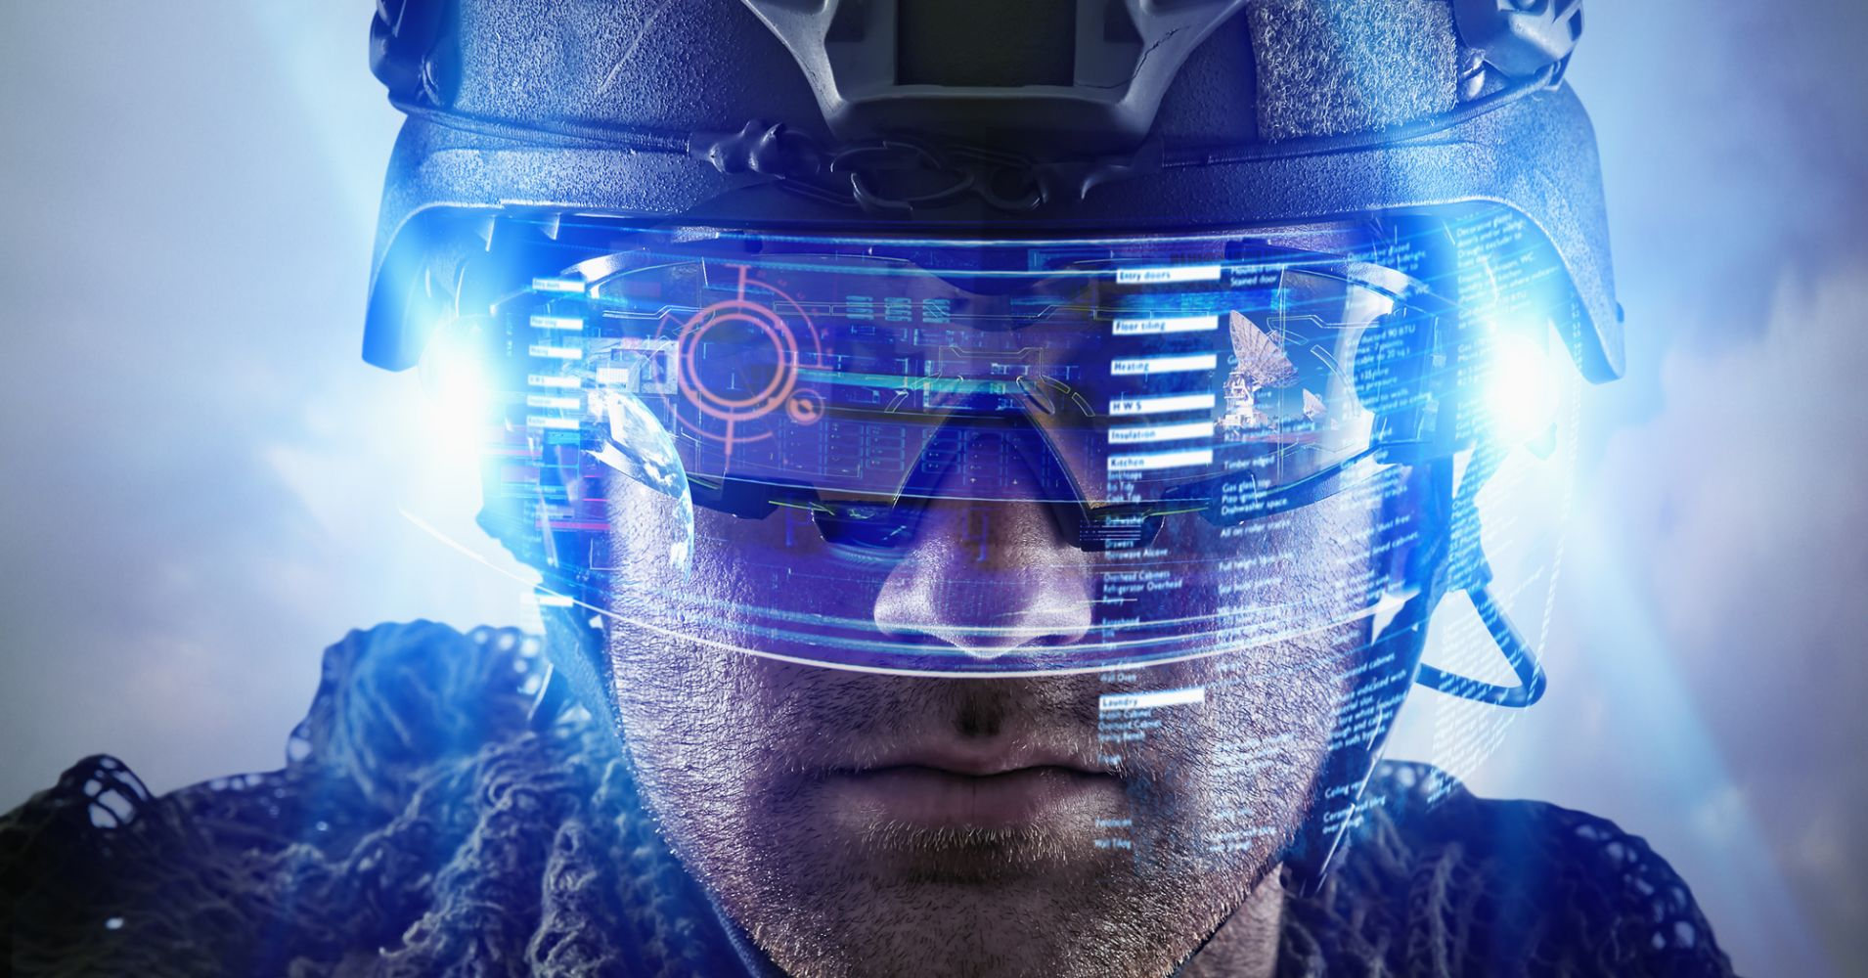
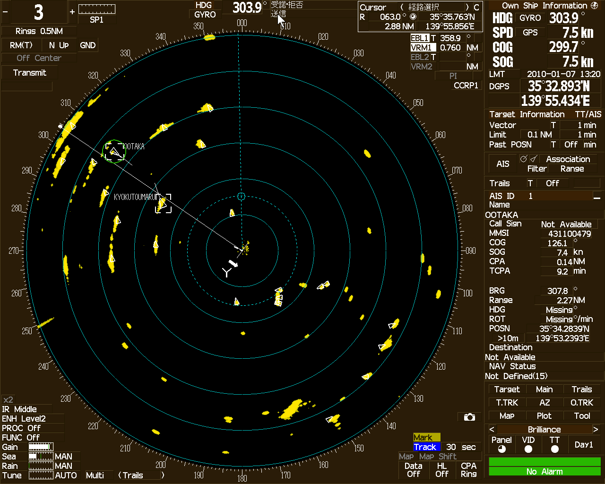
Alertness
Impulse Control
Notes:
The most basic one is alertness. To illustrate, watch the red dot ticking over the dial. You need to watch very carefully, because every now and then it skips one position. This double jump is your signal to respond. Your response time on this task, its consistency and occasional lapses are important markers of your capacity to sustain attention on the task at hand. It’s basic vigilance, but it underlies your capacity to work with this [click]. or this [click]. Vigilance metrics are quite sensitive to fluctuations in your functional state, such as sleepiness or drowsiness, that can lead to catastrophic errors. [click] Alertness provides the foundation for more complex cogntive functioning, such as is impulse control. We use another set of tools to measure it.

Slide 6
What’s the font colour below?
BLUE
YELLOW
GREEN
RED
The Stroop test
(impulse override)
YELLOW
Notes:
To illustrate, can I ask you to name the colour of the font as soon as you see it the screen – quick and loud! [C],[c],[c], [c] So you’ve just experienced a response over-ride task. This classic Stroop test goes back to 1930-s. You respond faster and make less errors if the font colour is the same as the written word (congruent trials). The difference in response time and errors between these and incongruent trials where the font colour is different from the meaning of the word, is a marker of inhibition capacity or impulse control.

Slide 7
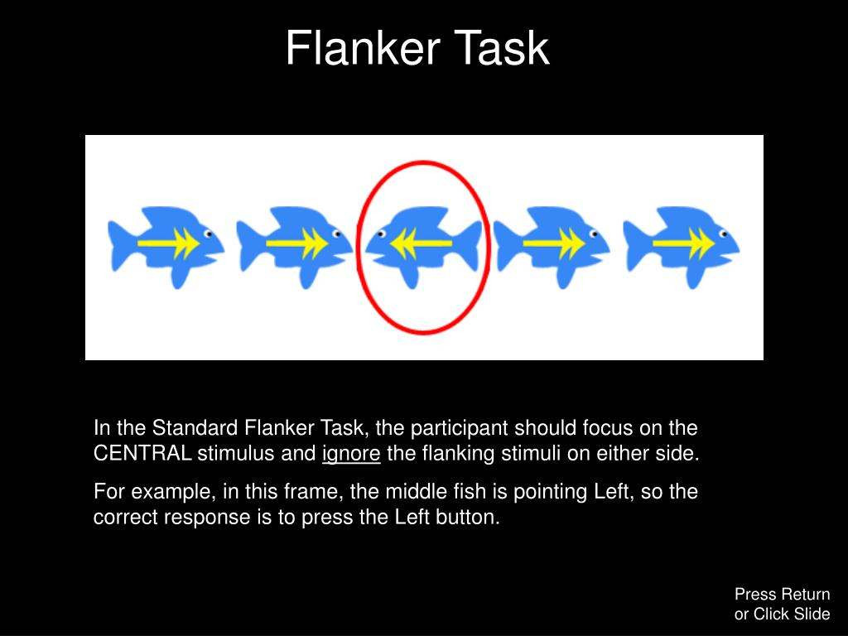
Notes:
Closely related to inhibition control, is our capacity to ignore distractions (as shown on this slide with a well-established Flanker test measuring distraction cost) here you have to ignore the direction all fish are facing, except the middle one. And when the flanks are helping, you go faster and with less errors, compared to when they mix you up by facing in the opposite direction. Plus an important capacity to switch between tasks and rule sets with the task (next)

Slide 8
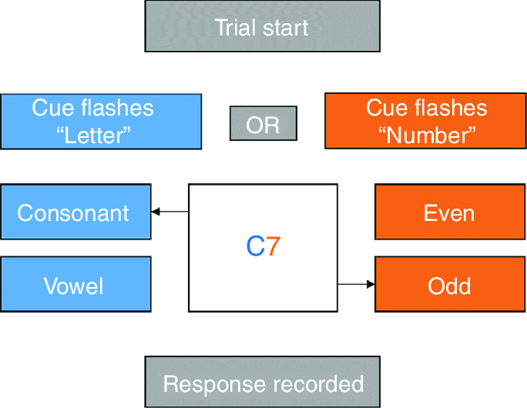
Notes:
Which is illustrated here. You get a 2-symbol combination with a letter and a digit. Your task is to tell a vowel from consonant, or an even number from odd. A cue before each trial dictates which of the two rules to apply. Not only you get letter trials mixed up with number trials, you also get repeat trials (when the cue doesn’t change from the previous trial) and change trials (when it does). The difference in response times and errors between repeat and change trials is a good marker of your switching capacity, which, together with impulse control and working memory, are the core elements of the so-called Executive function – a cognitive capacity to control the initiation, monitoring, and termination of all goal-directed actions. Executive functioning underpins self-regulation and Self-Control as we know it in SpPsy. EF is also a sensitive marker of cognitive deficit in clinical populations, including Traumatic Brain Injury. This is why it is routinely measured on the sidelines of any footy game …to diagnose concussion… and in the battlefield with the tools like this one –

Slide 9
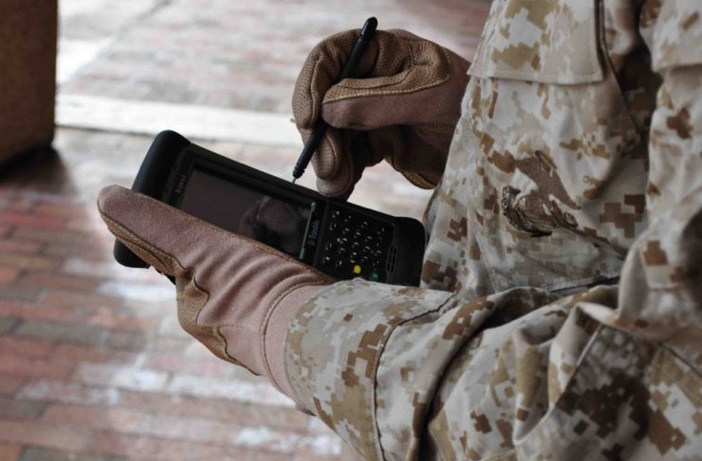

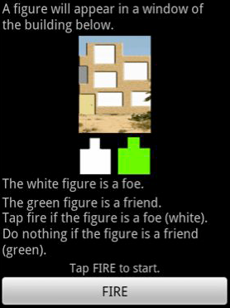
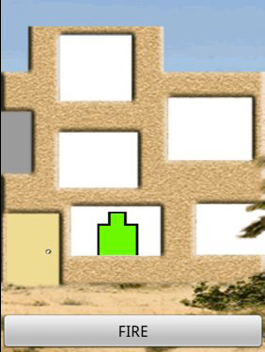
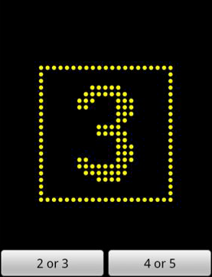
DANA:
Executive control: inhibition + switching + updating
Notes:
The Defence Automated Neurobehavioural Assessment battery (DANA, measuring simple reaction time [target on the R], procedural decisions [digit on the R] and impulse control in a Shoot-NoShoot task on the L. We have used this tool to measure cognitive decline in sleep-deprived soldiers.
Our daily life is critically dependent on Executive Functioning . It kicks in each time automatic or previously learned behaviour, can no longer achieve the goal. Hence, Executive Functioning is critical … not only for real-time performance, but also for a whole range of life-long outcomes – from academic achievement to health and longevity …(we have over 50 years of quality research to show for it).

Slide 10
Walter Mischel
40 years on: longer wait for 2 marshmallows predicted:
  Higher school grades
  Better cope with teenage problems
  Higher level of education attained
  Lower substance abuse (alcohol, smoking, drugs)
  Lower divorce rates
  Less conflict with law
  Lower BMI = less obesity
The Marshmallow Test
1 now or
wait for 2?
Notes:
It all started with a marshmallow… Walter Mischel’s work on “Delayed Gratification” kick-started this paradigm shift nearly 60 years ago: in his Marshmallow test a 4-yo was offered 1 marshmallow that he/she can eat right away, or 2 if they wait for the experimenter to come back. Experimenter never comes back, the child’s waiting time is measured until their first bite into any of the marshmallows. This simple timing metric turns out to be highly consequential! The kids from Mischel’s original experiments were followed up for 40 years now, and the pattern is clear: [Click] those able to wait longer for their childhood treats, ended up with higher school grades, better coping skills, higher level of education and income, less conflict with the law and even better health.

Slide 11

Notes:
For example, waiting time a the age of 4 predicts key health measures 30 years later – e.g., BMI and cardiovascular health. Every extra minute of waiting for the marshmallow at the age of 4 predicted an average reduction in the BMI by .2. This modest gain is in fact one of the largest observed longitudinally. And obesity epidemiologists agree that it makes a big difference.

Slide 12
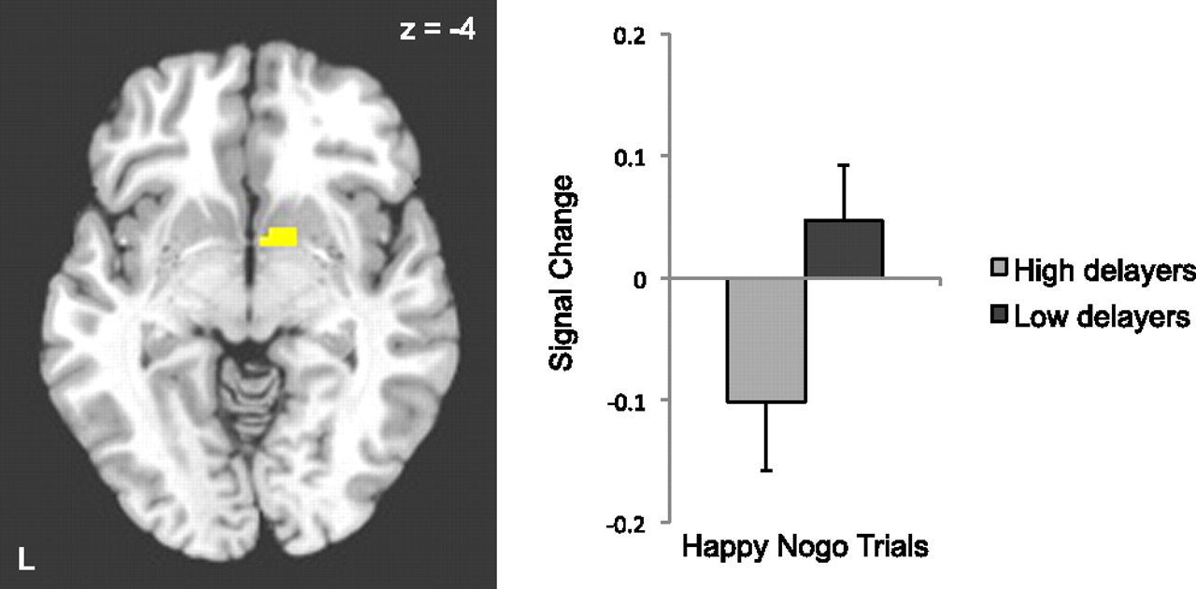
Behavioral and neural correlates of delay of gratification 40 years later
B. J. Caseyª,¹
Go/noGo: key inhibition f
(a) low delayers make more errors
to “hot” cues (emotional faces)
(b) no difference to “cool” (neutral) cues
Casey B J et al. PNAS 2011;108:14998-15003
Notes:
Neuroscience evidence is also very solid. Those poor at waiting for the marshmallow, 40 years later suffer an over-activation in the key brain areas involved in inhibiting responses to social cues. As a result they make more errors in the go/nogo tasks, especially when the cues are “hot” (or emotionally charged, such as emotional facial expressions).
Why does this matter? Because it connects the delayed gratification at the age of 4 to the cognitive capacity that will drive soldier’s ability to discriminate their targets from non-targets in the heat of the battle.

Slide 13
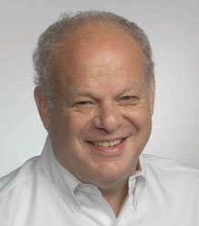
Self-control and delayed gratification
Self-discipline among 8-graders
  Self-report
  Parent and teacher ratings
  Choice: $1 now or $2 in a week
Those who chose $2 – higher self-discipline ratings
Martin Seligman
Composite self-discipline rating predicts:
  School grades
  Absenteeism (lack of)
  Likelihood of being selected into advanced high school programs
        Duckworth, A. L., & Seligman, M. E. (2005). Self-discipline outdoes IQ in predicting academic performance of adolescents. Psychological science, 16(12), 939-944.
Notes:
Extending the Marshmallow experiment, Seligman and colleagues (the originators of both the Positive Psych and the Comprehensive Solider Fitness paradigms) showed in a broad student population that self-discipline beats the IQ hands-down in predicting academic performance, with an age-appropriate version of the 2-marshmallow task. They simply double the payment for participation to those student participants who agreed to wait for the money in the mail. Low and behold - those who chose to wait were the ones with higher attendance, grades, and better chance of being selected into advanced academic programs

Slide 14
inattention
impulsivity
frustration tolerance
hostility
roughness
resistance
restlessness
persistence
Moffitt, et al. (2011). PNAS, 108(7)
Notes:
SC is even more important from a broader, populational perspective. In the famous Dunedin study, over a 1,000 newborns were assessed at multiple time points by parent, teacher & other observers [cli] on impulsivity, inattention, frustration tolerance, [and the like] combining to an aggregate Self-control gradient score.They were tracked for 30+ years with comprehensive medical assessments incl. cardiovascular, immune & mental health, levels of education, income and criminal history (using actual Police and court records). [cli] After controlling for all possible confounds (such as Socio-economic status and the IQ),

Slide 15
SC stability = 0.30
SC_{change}(age 5→21) = unique predictor over SC (age 5)
Moffitt, et al. (2011). PNAS, 108(7)
Early SC nudge → massive life-long impact
Notes:
the SC gradient measured in early childhood predicted all measures of adult Health, wealth and criminality: with high childhood SC linked to lower Health risks on the L panel, from the immune and cardio-respiratory to substance dependence; and to higher income and lower financial problems on the R panel. Good news: [click] Self-control can improve! Stability coefficient from age 5 → age 21 is only 0.3, which leaves 70% of variance in Self-control open to improvement. Even better, [click] change scores from age 5 to 21 added unique predictive power over an above the baseline predictor: those who lifted their Self-control rank at age 21 – went on to improve all their life outcomes at 32! We don’t know what caused the improvement – this study observed natural variability without any experiment, [click] but imagine what a custom-designed training could do if it nudges self-control up across the population! Bottom line: Self Control contributes to just about all important life outcomes – from mental and physical health to peak performance and professional success. The evidence is compelling enugh to start searching for methods of systematically improving SC, its active ingredients and other related elements of CF.

Slide 16
Cognitive Fitness: Working Definition
CF = Multi-faceted and differentially malleable capacity to deploy neurocognitive resources, knowledge, and skills to meet the demands of operational task performance, and to sustain this performance throughout a career- and life-long application
Key points:
1. CF – multiple capacity factors that are different from knowledge and skills
2. Operational task performance is core to defining the relative importance of these factors
3. Trainability of individual CF factors is to be established empirically → select-train-augment
4. Resilience, well-being and longevity as by-products of fitness
Notes:
Similar to the physical power, flexibility and endurance at the core of strength and conditioning, You can think of CF as a set of cognitive capacities such as inhibition and cognitive flexibility underpinning all cognitive skills – from reading and remembering to problem solving and handling stress and frustration. More specifically - our capacity to deploy neurocognitive resources, knowledge, and skills to perform cognitively demanding tasks, and to sustain this performance over extended periods
Key points in this working definition:
1. CF is a bunch of capacity factors that are different from knowledge and skills
2. Operational task performance is core to defining the relative importance of these factors
3. Trainability of individual CF factors is to be established empirically → evidence-driven choice between selection-training-or-augmentation applications
4. Sustained performance suggests that resilience, well-being and longevity are by-products of fitness – which is quite distinct from the tradition of direct pursuits of resilience and well-being

Slide 17
Cognitive Fitness Framework
Advanced training
  Controlled response (“The Zone”)
  Energy management (arousal regulation)
  Situation Awareness (detect → interpret → predict)
  Decision making: bias & confidence calibration
  Adaptability
  Teamwork
Chronic Stress Prevention
CF2
Cognitive Readiness:
Tolerance & Resistance
Operational cognitive performance
Cognitive Recovery
Cognitive Fitness: Trainable cognitive primaries
Cog Gym
Foundational Training
  Self-awareness
  Attention skills
  Task Switching
  Impulse control
  Co-action
Mission-ready training
  Tolerance to pain, stress, sleep loss, monotony
  frustration, uncertainty, tactical surprise
  Resistance to distraction, deception, manipulation
  Resilience & recovery dynamics
Gold-standard Training:
Isolate
↓
Overload
↓
Over-recover
Cognitive Recovery
  Sleep hygiene
  Meditation
  Nutrition
  Social support
Operational augmentation
  Cognitive state monitoring
  Fatigue countermeasures
  Adaptive decision aids
  Operator state-aware autonomy
Notes:
Now, how can we distinguish these capacities from the broader set of psychological skills sport psychs are more familiar with? The distinction is never black and white, as capacity is always embedded in skill – like your leg press is never a perfect match to your squat, and VO2max on treadmill will differ from your VO2max on bike. We can help clarify the differences by linking them to the phases of the training cycle: from the foundational to the advanced, mission-ready, and recovery phases. For example, [CLICK] cognitive primaries, such as attention, impulse control, and co-action, that underpin most cognitive skills, can potentially be trained through the gold-standard “isolate—overload—recover” protocols at the initial, Cognitive Gym phase. [CLICK] More advanced training targets at the CR phase include stress management (arousal regulation), adaptability, teamwork, situation awareness (including detection, sense-making and prediction) and decision making (de-biasing and confidence calibration). [CLICK] The mission-ready training phase is focused on tolerances (from pain and sleep loss to monotony, frustration and uncertainty) and resistances (to distraction, deception or manipulation). [CLICK] These capacities get further enhanced through operational support (with tools such as decision aids and fatigue countermeasures). [CLICK] The recovery phase completes the cycle, employing both reflexive (e.g., mindfulness) and restorative practices (e.g., healthy eating, hydration and sleep hygiene) and relying on social support. [CLICK] The full cycle reinforces the cognitive fundamentals that are known for their contribution to both real-time cognitive performance and resilience that helps prevent the accumulation of Chronic Stress and enables career longevity and life-long thriving.

Slide 18
Cognitive Fitness Framework
Advanced training
  Controlled response (“The Zone”)
  Energy management (arousal regulation)
  Situation Awareness (detect → interpret → predict)
  Decision making: bias & confidence calibration
  Adaptability
  Teamwork
Chronic Stress Prevention
CF2
Cognitive Readiness:
Tolerance & Resistance
Operational cognitive performance
Cognitive Recovery
Cognitive Fitness: Trainable cognitive primaries
Cog Gym
c – factor: Team “smarts”
Collective intelligence
Foundational Training
  Self-awareness
  Attention skills
  Task Switching
  Impulse control
  Co-action
Mission-ready training
  Tolerance to pain, stress, sleep loss, monotony
  frustration, uncertainty, tactical surprise
  Resistance to distraction, deception, manipulation
  Resilience & recovery dynamics
Gold-standard Training:
Isolate
↓
Overload
↓
Over-recover
Cognitive Recovery
  Sleep hygiene
  Meditation
  Nutrition
  Social support
Operational augmentation
  Cognitive state monitoring
  Fatigue countermeasures
  Adaptive decision aids
  Operator state-aware autonomy
Notes:
This framework connects multiple lines of Research effort. [CLICK] E.g. multiple elements of foundational cognitive training being developed by several research groups under the construct of Cognitive Gym. [CLICK] our emerging work on Team Decision Making [CLICK] is looking at the so-called c-factor – collective intelligence or team “smarts”. This c-factor has surprisingly little connection to the individual “smarts” of team members, and instead has been linked to their interactional competence and team diversity. And our augmentation work is currently focused on fatigue countermeasures - here is an example

Slide 19
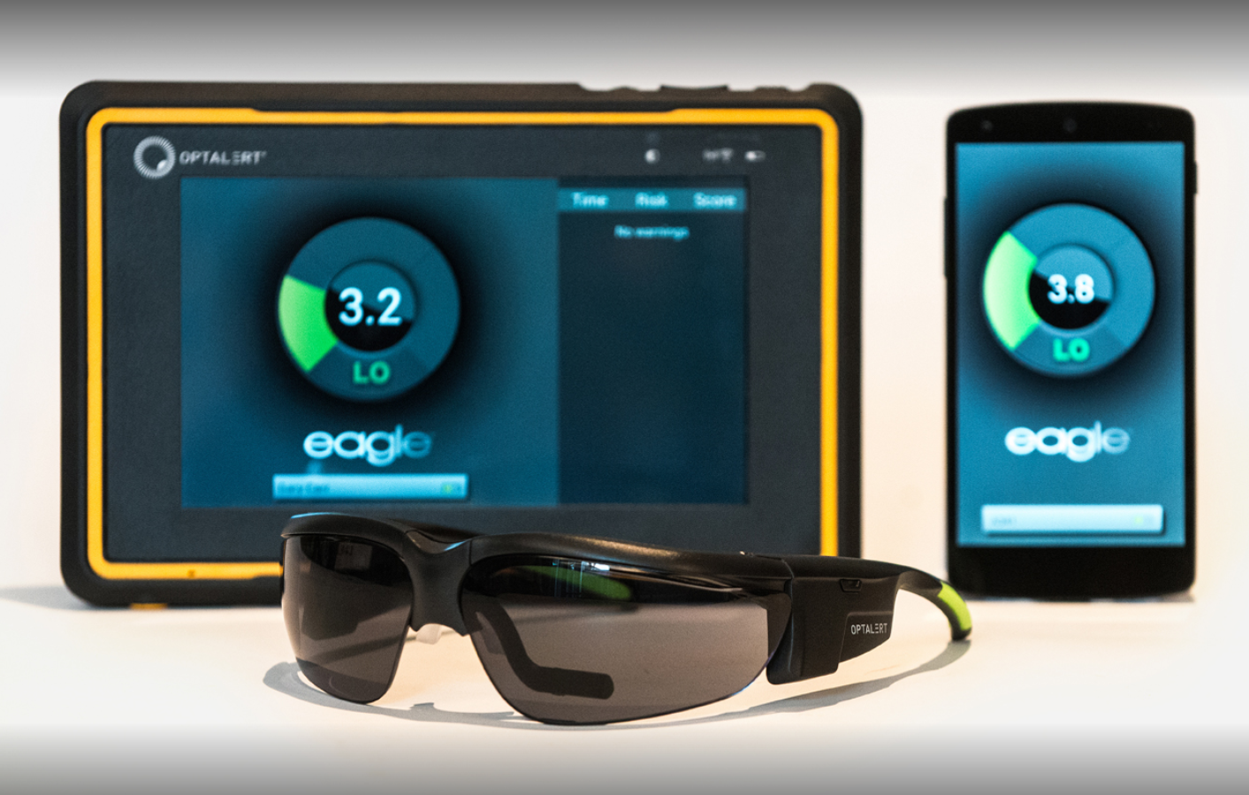
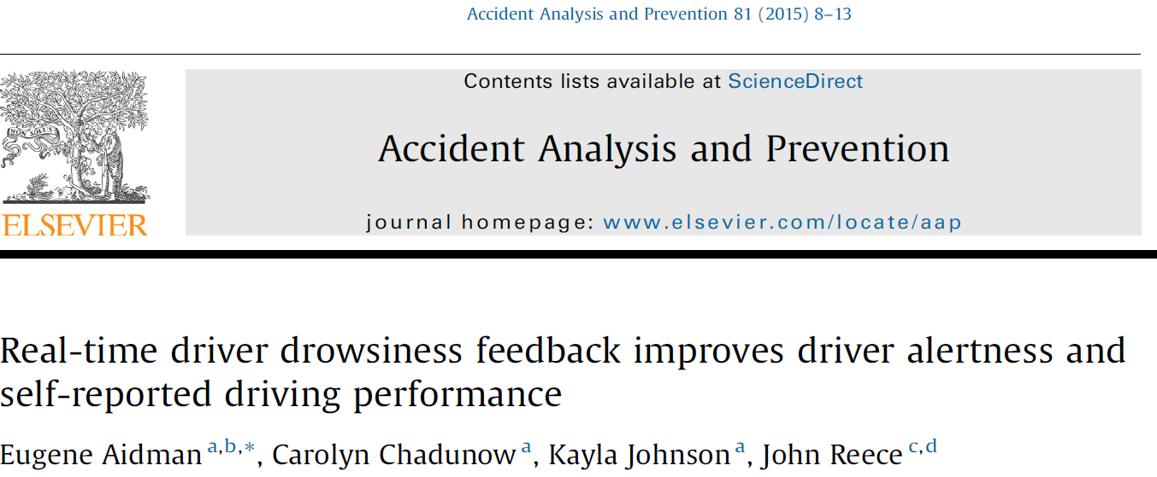
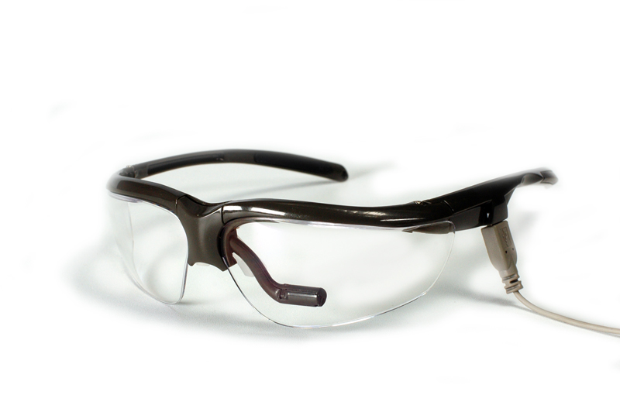
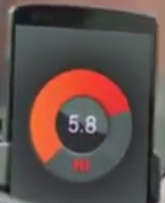
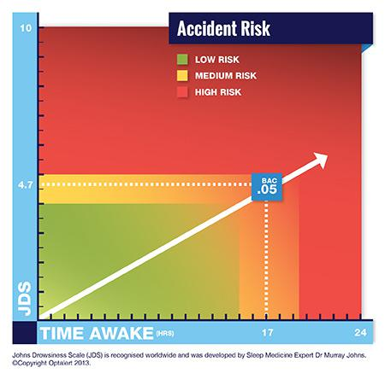
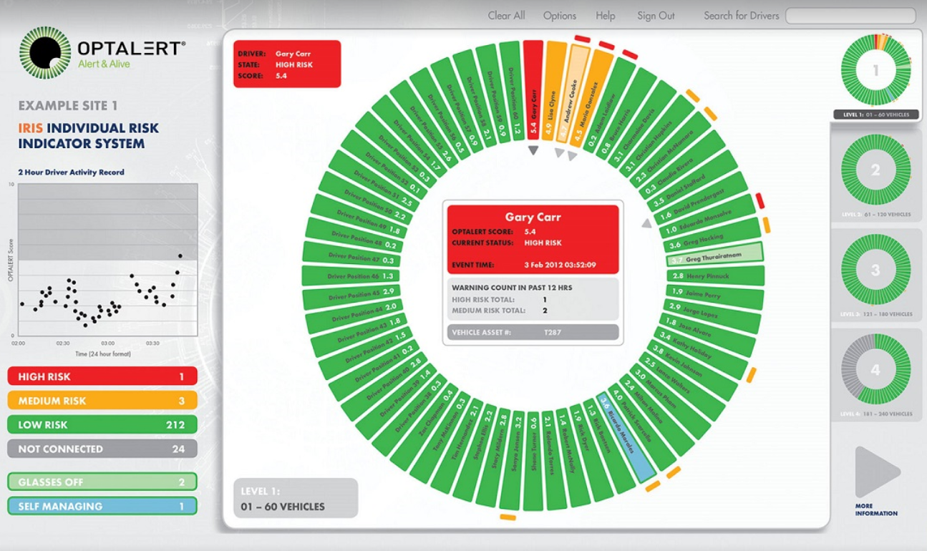
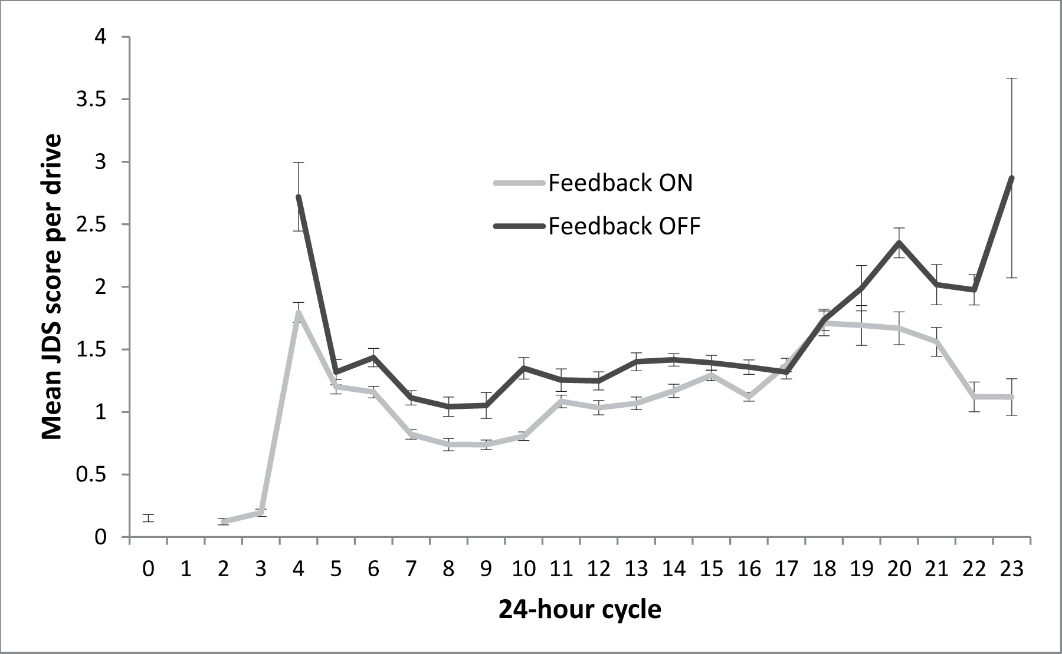
Application: Monitoring Drowsy Drivers
UNCLASSIFIED
Drowsiness lower with Feedback ON
F(1, 623.04)=23.13, p<.001 η²=.04, 95%CI[.01, .07]
Notes:
Cognitive fatigue is a massive issue costing the economy billions of dollars in accident risks and productivity losses, and can turn deadly on the road – let alone in high-risk missions. Our field trial for a Combat Engineering regiment aimed at measuring the levels of chronic fatigue in the unit and evaluating a method to mitigate it in extended driving tasks. For this we trialled an infra-red blink sensor mounted on a spectacle frame. Turns out that how fast you re-open your eyes after a blink is a solid marker of drowsiness – comparable in sensitivity to hospital-grade gear used to diagnose sleep disorders. Clinical trials had produced a risk scale (bottom L) with its Green-Amber-Red zones, which made this blink metric so effective that mining truck drivers around the globe have to wear these glasses, with the blink data beamed up to the control centre where a trained health practitioner would watch drivers, up to 60 a pop, in a daisy diagram and decide on mitigation steps for each driver whose petal turns from green to amber, let alone red. This Big-Brother solution was not acceptable for Defence, [click] so we looked at the effect of feeding the blink–metrics direct to the driver in real-time on a dashboard display. We managed to nest a randomised cross-over experiment inside this field trial and the data confirmed that real-time feedback did improve alertness and reduced driving risks. [click] fast forward several years – and the same technology has not only gone wireless and replaced its massive data-loggers with a smartphone, but it also added a dash-mounted display that utilises the effect we discovered with army drivers.

Slide 20
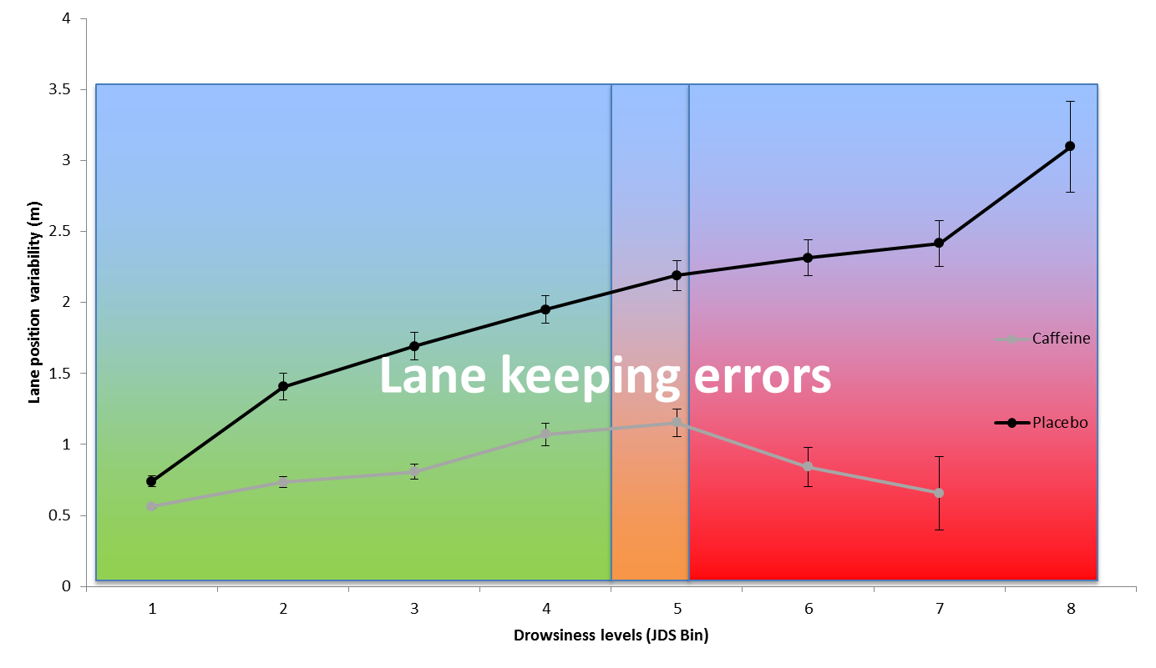
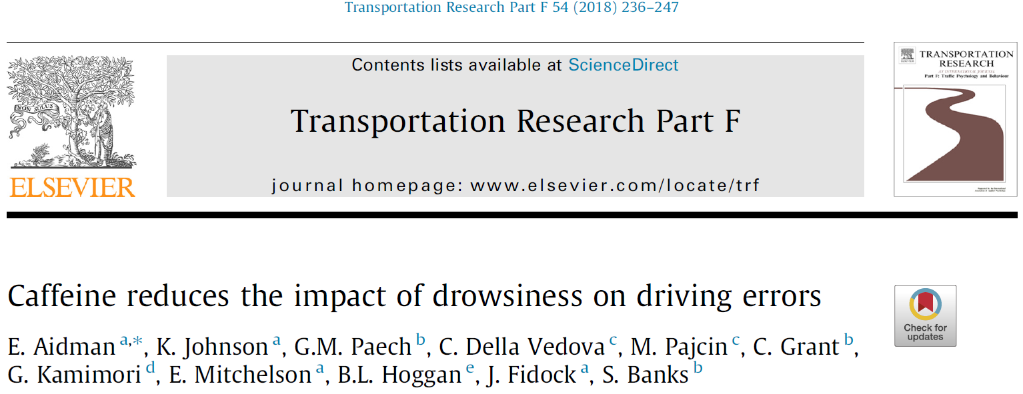

Caffeine disrupts the impact of real-time sleepiness on driver errors
Notes:
When we applied the same blink sensors to monitor driver sleepiness over TSD, up to 50hrs of it in some of our studies, we observed that chewing a pellet of caffeinated chewing gum, significantly reduced driving errors in a simulated driving task, such as erratic acceleration, veering off the road, or crossing into the opposite lane - much more than you’d expect to result from a mild reduction in sleepiness typically linked to caffeine intake. Those consuming caffeine got smashed nearly as badly as those who chewed a placebo gum, but made far fewer errors, and their errors did not depend on how drowsy they were –so caffeine effectively destroyed the well-known association between drowsiness and task errors. We found a similar dissociation between real-time drowsiness and task errors when we replaced driving with standard cognitive tasks – from simple reaction time to procedural decisions and response inhibition.

Slide 21
Notes:
DSTG-led international research team discovered that its non-digestive form – caffeinated chewing gum – can be used in safe doses to rescue cognitive performance under serious sleep deprivation. Thumbs up to our partners from UniSA and WRAIR!
In a gold-standard double-blind placebo-controlled experiment young healthy adults were sleep deprived for 50 hours (2 consecutive nights without sleep) and drove along a simulated outback road for 40 minutes every 3 hours (15 trips in total), while hooked up to an eye-blink sensor monitoring their drowsiness. Half the group chewed on caffeine-infused chewing gum in the early hours of the morning, the other half (placebo group) consumed the same gum but without caffeine. Drowsiness crept up as sleep deficit accumulated in both groups - not much of a difference between them. You would expect task errors (such as veering off the road or missing a target on a cognitive test) to follow the ups and downs of the fluctuating drowsiness. To our surprise, that was true only in our placebo group. Those who chewed caffeinated gum, managed to keep their task errors low even when their drowsiness was creeping up. This is quite radical: the gum, consumed in carefully timed, safe doses, protected cognitive performance not only through its well-established mild alerting effect, but also by reducing the impact of fluctuating alertness on task errors

Slide 22
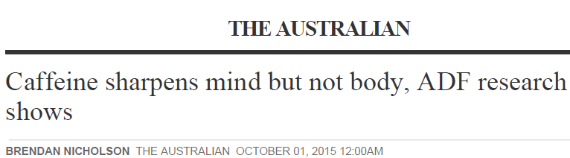
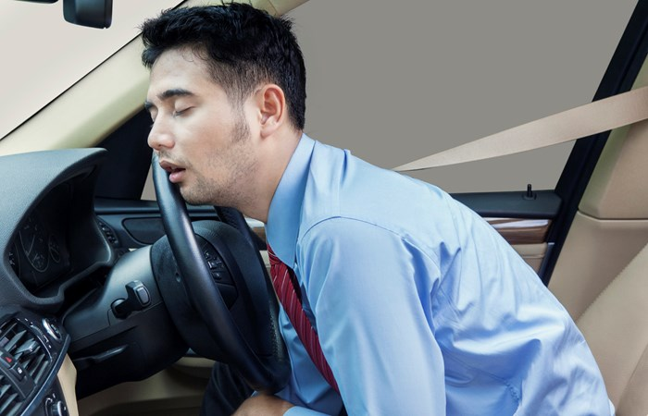

Caffeine can reduce driver mistakes, study shows
Gold standard: randomised, double-blind placebo-controlled study
A Defence fatigue study has found caffeine gum can reduce driver error in sleep deprived people. The international collaborative study also involved UniSA Sleep Research Centre, Walter Reed Army Institute of Research (US) and Monash University Accident Research Centre.
Notes:
We had a few interesting Media responses to the study …
That work also highlighted the critical role of recovery in maintaining CF – our fatigue profiling did not show any difference in chronic fatigue between our reservist group and the rest of Defence or even populational norms, despite a heavy increase in acute fatigue. Their secret was in recovery (self-reported in that instance, but measured with actigraphy in our other studies). So getting smashed at the end of the day is no problem if you are good at recovery – down time, sleep, nutrition (became a critical phase in CF2).

Slide 23
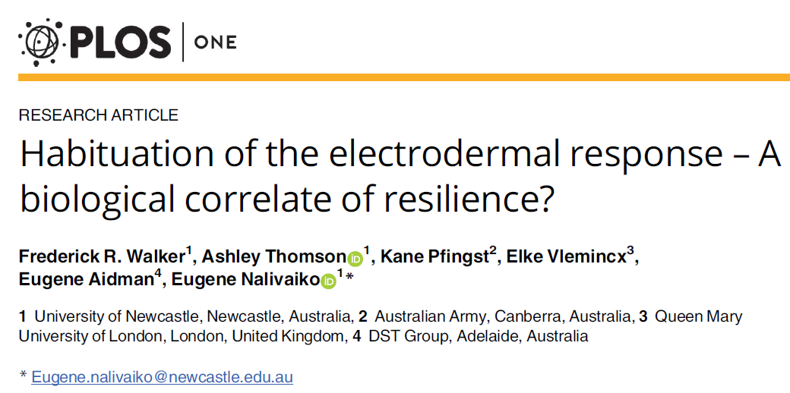

Biomarkers of Stress and Resilience
: raw data
: habituation slopes
Low-resilient
(CD-RISC = 39)
High-resilient
(CD-RISC = 78)
Notes:
Here is another example - our work on Biomarkers of Resilience. When we hear a sudden, loud noise - we respond with a spike in heart rate, instant sweat, disrupted breathing etc., collectively known as acoustic startle. We can measure this stress response with multiple body sensors, the simplest being skin conductance – one of the fastest stress response systems in your body. If the same loud noise is presented repeatedly, our stress response typically declines – we get used to the stimulus, or habituate. It turns out that how fast you habituate to acoustic startle is linked to several markers of resilience. Early studies discovered that these Habituation slopes were sensitive enough to distinguish patients with PTSD from healthy controls – and more importantly, from other clinical groups such as Anxiety and Depression. PTSD folks did not habituate at all! Our own study showed that the same starle slopes can discriminate between high-and low-resilient individuals in the healthy population, with no clinical diagnosis, but some of whom may be at risk. This is quite remarkable, almost a breathaliser-type objective method to assess the risk of PTSD.

Slide 24
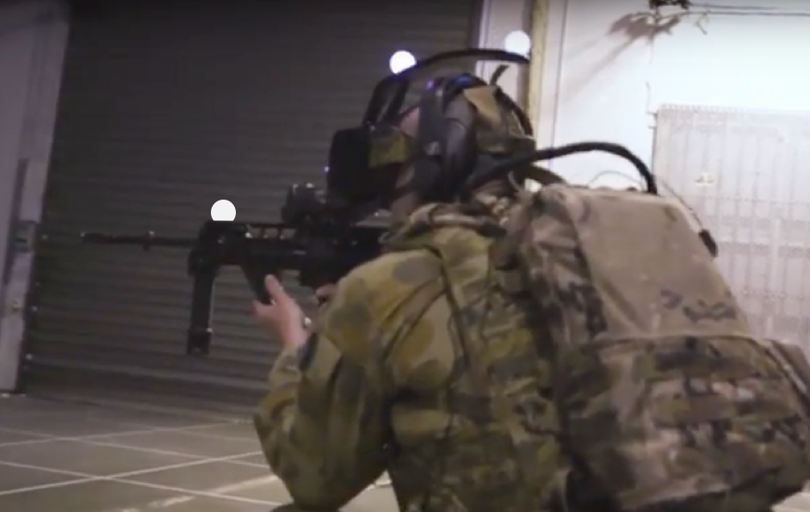

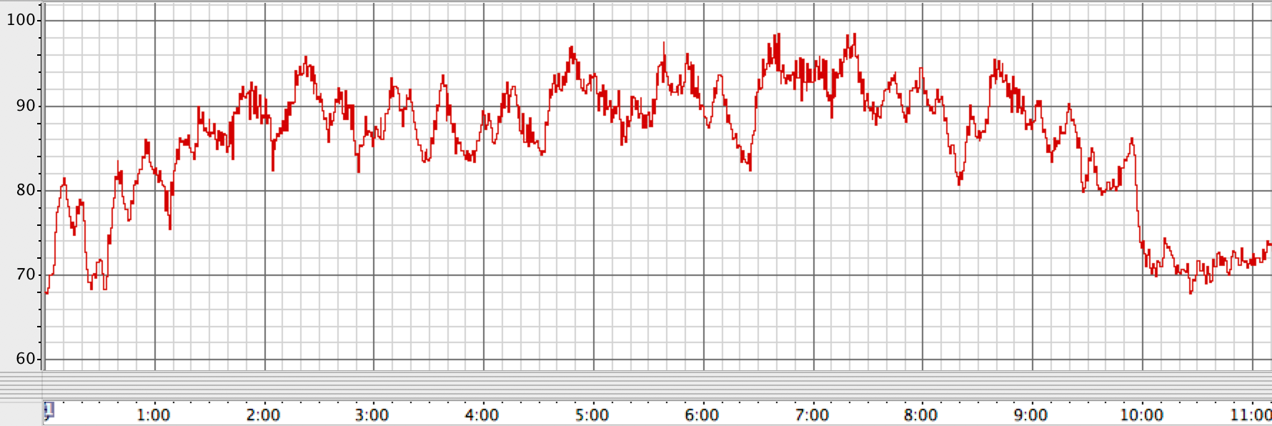
Biomarker-enhanced free-roam VR
Promising technology for tactical training
Heart rate
HR
recovery
Stressful tactical task (room clearance)
min
Notes:
Extending this work into VR environments is another promising direction. VR-based training is going through its own hype cycle. The problem with desktop or armchair VR is the limited stress response it produces - every one knows it’s a game. The free-roam VR (FRVR) provides a more realistic & challenging environment. We were able to confirm that FRVR can produce substantially higher stress levels as you can see in this trial data - showing elevated Heart and respiratory rate during the task. We also saw a clear dose-response effect there, with objectively measuered stress response increasing from a walk-through scenario to fully blown room clearances with growing complexity of OPFOR actions. With this methodology, we are beginning to track the stress response during training serials and introduce elements of stress management skills such as resonant frequency breathing – with or without instrumented feedback – and to see how effective this training is in optimising the operators’ stress response.

Slide 25

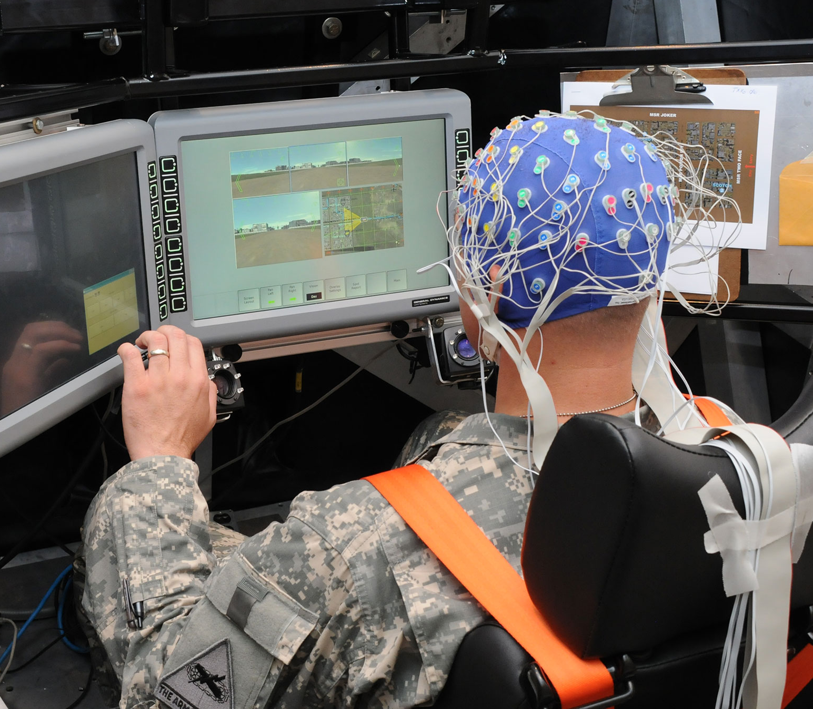
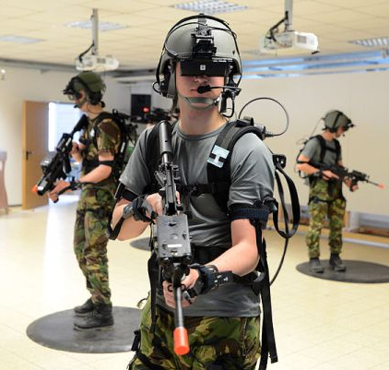
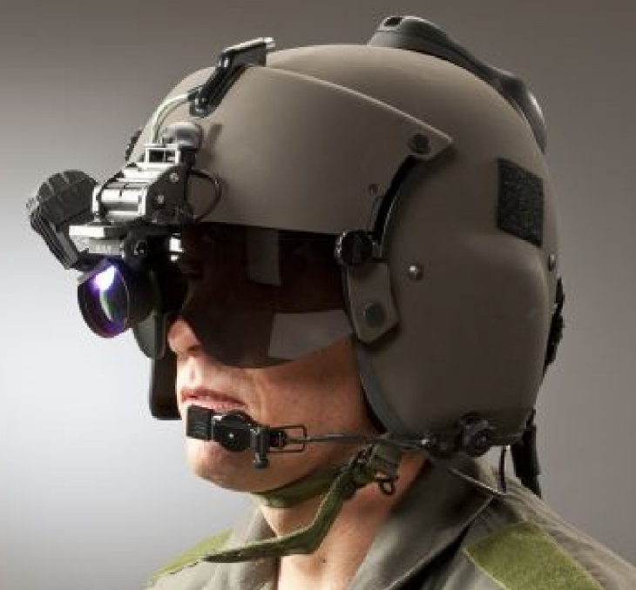
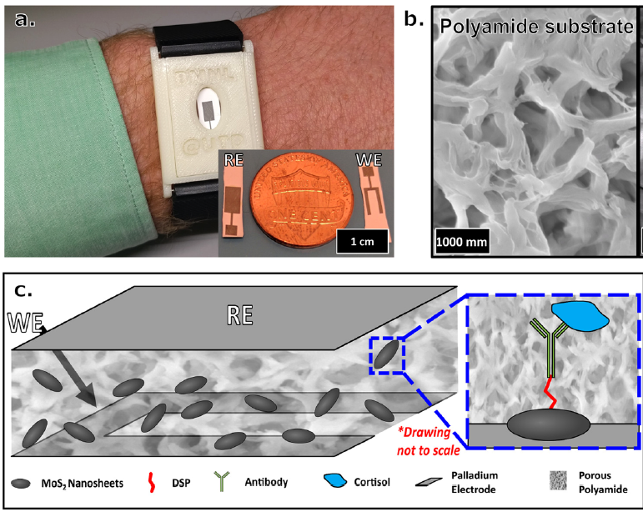
Future Directions
Psychometrics
VR, AR &
Mixed Reality
Data fusion
& mining
Body & Brain Sensors
Game Design
Functional state & cognitive markers feed real-time feedback (e.g., safety warnings) system behaviour (“sliding autonomy”)
Embedded sensors: HR, EMG, EEG, MEG, eye-blinks, GSR, etc. tracking operator’s functional state
Embedded loggers to track RT, error rates, voice pitch, haptic pressure, keystroke cadence & other markers of cognitive capacity
Notes:
What does the Future hold? 1st we’ll see a push integrating body & brain sensors, with action logging, to enable real-time, unobtrusive measurement beyond physiology: [click] wearable systems are moving to fusing the biomarker data such as HR, EMG, EEG, eye-blinks, skin conductance with embedded action loggers tracking RTs, error rates, voice pitch, haptic pressure, keystroke cadence & other markers of cognitive capacity to track the operator’s functional state.
We will also see exponential growth in the Virtual, Augmented and Mixed reality applications – both for training and assessment scenarios. All of that has to be backed up by serious data fusion capability at multiple time scales, plus data mining and machine learning to complement, and ultimately replace the conventional psychometrics.
And most importantly, systematic evidence base will be built with validation of the new methods, from sensor systems to the protocols deploying them.

Slide 26
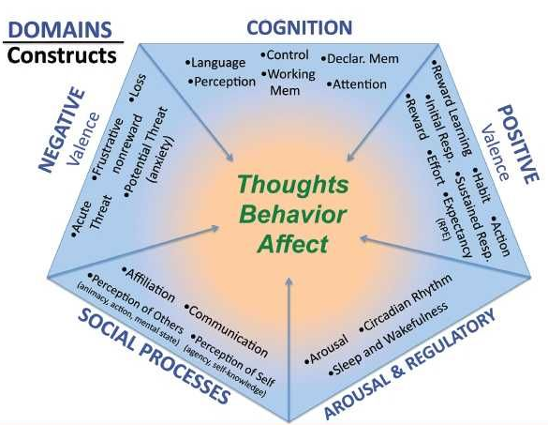
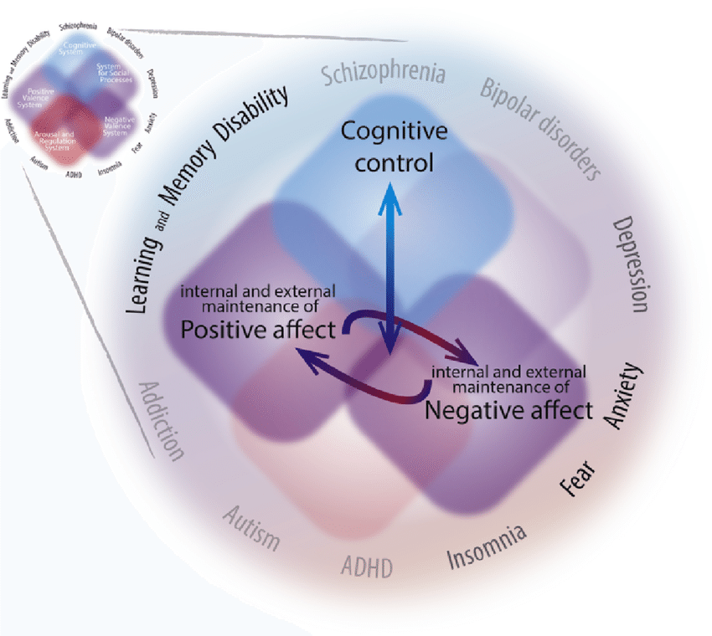
Future Directions: Research Domain Criteria
RDoC
+ valence
– valence
cognitive
regulatory system
social processes
RDoC
Notes:
One of the key drivers of progress in all our work is the push for dimensional characterisation and measurement of cognitive functioning. The Research Domain Criteria framework (RDoC in short) is the new frontiers here, developed by the Nat Institute of Mental Health to address the fundamental flaws of the outdated diagnostic systems such as DSM and ICD. The RDoC identifies 5 broad domains of psy functioning, that underpin all DSM diagnostic categories. They include + and - valence systems (responsible for things like mo, fear &anx), cognitive systems (incl. attn, WM, cog control), arousal & regulation system and social processes (such as perception of self and others). [click] These broad domains combine more than 40 functional constructs, and they are intended to replace the outdated diagnostic categories with biologically traceable measurement of the underlying dysfunction. This has revolutionised the clinical world: the focus has shifted from symptoms to root causes of clinical conditions, with tests spanning across conditions, and things like gambling and substance addiction studied together as a disfunction of reward responsivity under the +valence domain (more on that later in the Conference program). Importantly,

Slide 27
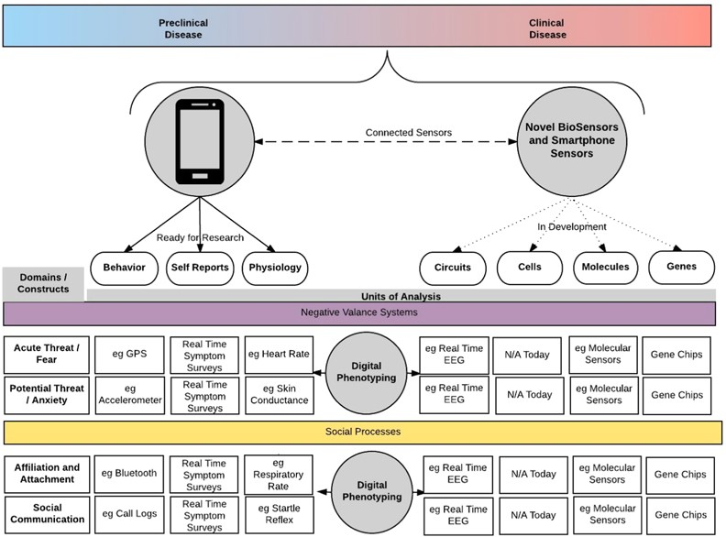
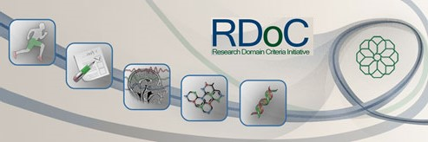
Future Directions: Frontiers of Measurement
Notes:
The RDoC deliberately populated its measurement space with measures at multiple levels – from behaviour, self-reports and physiology to neural circuits & bio-chemistry. And the RDoC matrix highlights the resulting blank spots [Click] which helps to stimulate and focus the measurement industry, including psychometrics. What’s critical to us is that RDoC measures are intended to span a full range from dysfunction to the norm, and all that was left to the CF2 is to extend this logic to include peak performance. The initial mapping of CF2 constructs is consistent with these broad RDoC domains. Our next question is about their relative importance in driving cognitive performance under different occupational settings. And that’s where we rely on methods like The Delphi to develop a broad expert consensus on the dimensions of CogFit. You’ll hear more about this exciting new project later at this Conference. The ultimate goal here is a framework that offers a common language, agreed measurement standards, and a mapping of constructs that are worth measuring and improving, in order to help our clients to meaningfully combine their well-being and performance aspirations. And to help ourselves establish substantive and mutually enriching connections to the clinical world where the crisply defined fitness constructs become as critical to the prevention of mental illness as they are to enhancing peak performance.

Slide 28







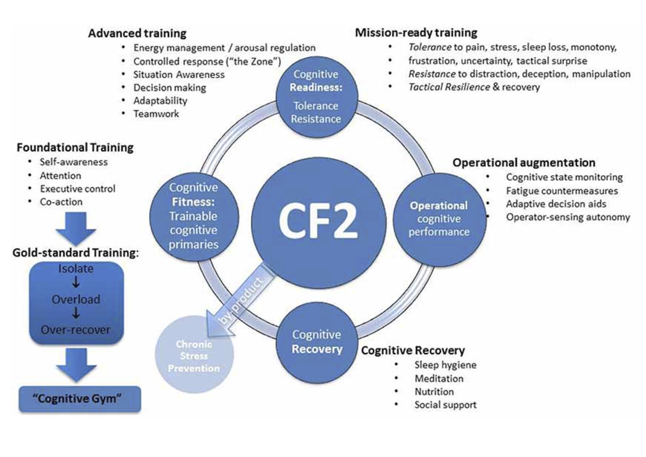
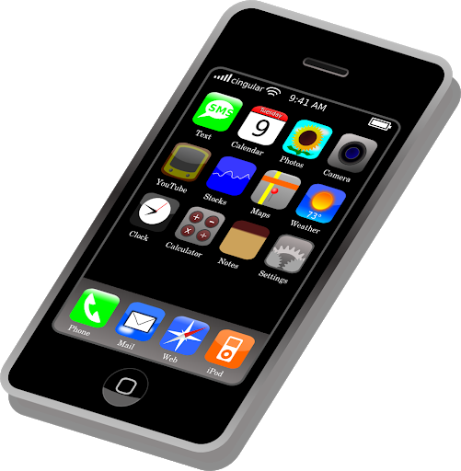
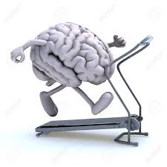
CF2 Program
Application domains
Projects
Defence
International Expert Consensus:
Delphi (Monash, HPRnet)
Law enforcement
Embedded Cognitive Assessment (UTas, USyd, Monash)
Emergency Services
Healthcare
Biometrics & VR (U of Newcastle)
Aviation
Cognitive Genomics (Adelaide U)
Performing Arts
Adaptability (USyd)
Sport & Exercise
Sleep & Decision Making Risks (Monash)
Business
CF2 App
CF2 App - industry (CoSEP, BPI) .
HPRnet (UQ, UWA) industry (CoSEP, BPI)
Components
Protocols
Training Programs
Resources
Facility Design
Equipment
Protocols
Program Design
Data Management
Cognitive Gym
Notes:
To summarise: we are at a point where we can begin to define and measure the elements of Cognitive Fitness, to design the environments and protocols to improve it, and to develop fieldable technologies to protect and enhance cognitive performance. The framework is generating new Qs : 1st, what are the pattern-forming elements of CogFit? The factors that can drive change (both positive and negative) in multiple other aspects of cognitive performance. [Click] Our Delphi study, led by Monash University is addressing this question. You’ll hear more about it later in the program. [Click] Next, how can we best assess the components of CF? new measurement protocols [Click] embedded in dynamic scenarios →[Click] gamified or simulation-based – are a real big news here, particularly when combined with biometrics and big data analytics. It is a genuinely disruptive alternative to traditional psychometrics.

Slide 29
CF2 Program
Application domains
Projects
Defence
International Expert Consensus:
Delphi (Monash, HPRnet)
Law enforcement
Embedded Cognitive Assessment (UTas, USyd, Monash)
Emergency Services
Selection – Training – Operational Support
Healthcare
Biometrics & VR (U of Newcastle)
Aviation
Cognitive Genomics (Adelaide U)
Performing Arts
Adaptability (USyd)
Sport & Exercise
Sleep & Decision Making Risks (Monash)
Business
CF2 App
CF2 App - industry (CoSEP, BPI) .
HPRnet (UQ, UWA) industry (CoSEP, BPI)
Components
Protocols
Training Programs
Resources
Facility Design
Equipment
Protocols
Program Design
Data Management
Cognitive Gym
Notes:
Then, How trainable are these CF elements? →[Click]. Should we train WM or just factor its limits into tactical decision aids? Shall we educate or train for impulse control – or should we select for it, if the early indications are confirmed that it is heavily genetically determined? →[Click] we have a growing research effort in Cog Genomics led by Uni of Adelaide → it will inform the decisions on what application types [Click] are more suitable for the different components of CF - (1) selection, (2) training or (3) operational support, … [Click]

Slide 30
CF2 Program
Application domains
Projects
Defence
International Expert Consensus:
Delphi (Monash, HPRnet)
Law enforcement
Embedded Cognitive Assessment (UTas, USyd, Monash)
Emergency Services
Healthcare
Biometrics & VR (U of Newcastle)
Aviation
Cognitive Genomics (Adelaide U)
Performing Arts
Adaptability (USyd)
Sport & Exercise
Sleep & Decision Making Risks (Monash)
Business
CF2 App
CF2 App - industry (CoSEP, BPI) .
HPRnet (UQ, UWA) industry (CoSEP, BPI)
Components
Protocols
Training Programs
Resources
Facility Design
Equipment
Protocols
Program Design
Data Management
Cognitive Gym
Notes:
our implementation work →[Click] includes the design and development of Modular training programs – here we have UoNewcastle leading the Def-focused development, and our College project focused on competitive sport, both aiming for flexible and tailored application. And similar projects are mushrooming, including a few from our HPRnet partners, now with a much clearer view of where they fit in the big picture. So, we are in a great company, [Click] in a ground swell of programs and applications, from non-technical skills in aviation to emergency medicine and corporate wellbeing, drawing from the NeuroCognitive, Clinical & and Performance Sciences, and where the clinical and performance specialists stand a good chance to leverage off each other. Thank you!

Slide 31
Questions?

