Slide 1
CoSEP – Australian Army
Special Project
Background Briefing
Risk Management Report
Chair, CoSEP
May 2020

Slide 2
Project is result of 10+ years of
research initiatives looking at
“performance under pressure”
conducted by a range of
organisations funded by grants
driven / directed by Defence needs
International
Development
Group
Brainpark
Monash
University
Performance
Enhancement
Systems
80 percent
Mental Consulting
Bond
Performance
Consulting
Biometrics Centre
University of
Newcastle
Mind Body Brain
Performance
Institute
Cognitive & Decision
Sciences
Sydney University
Defence Science
& Technology Group
Decision Making
Performance Under Pressure
Cognitive Readiness

Slide 3
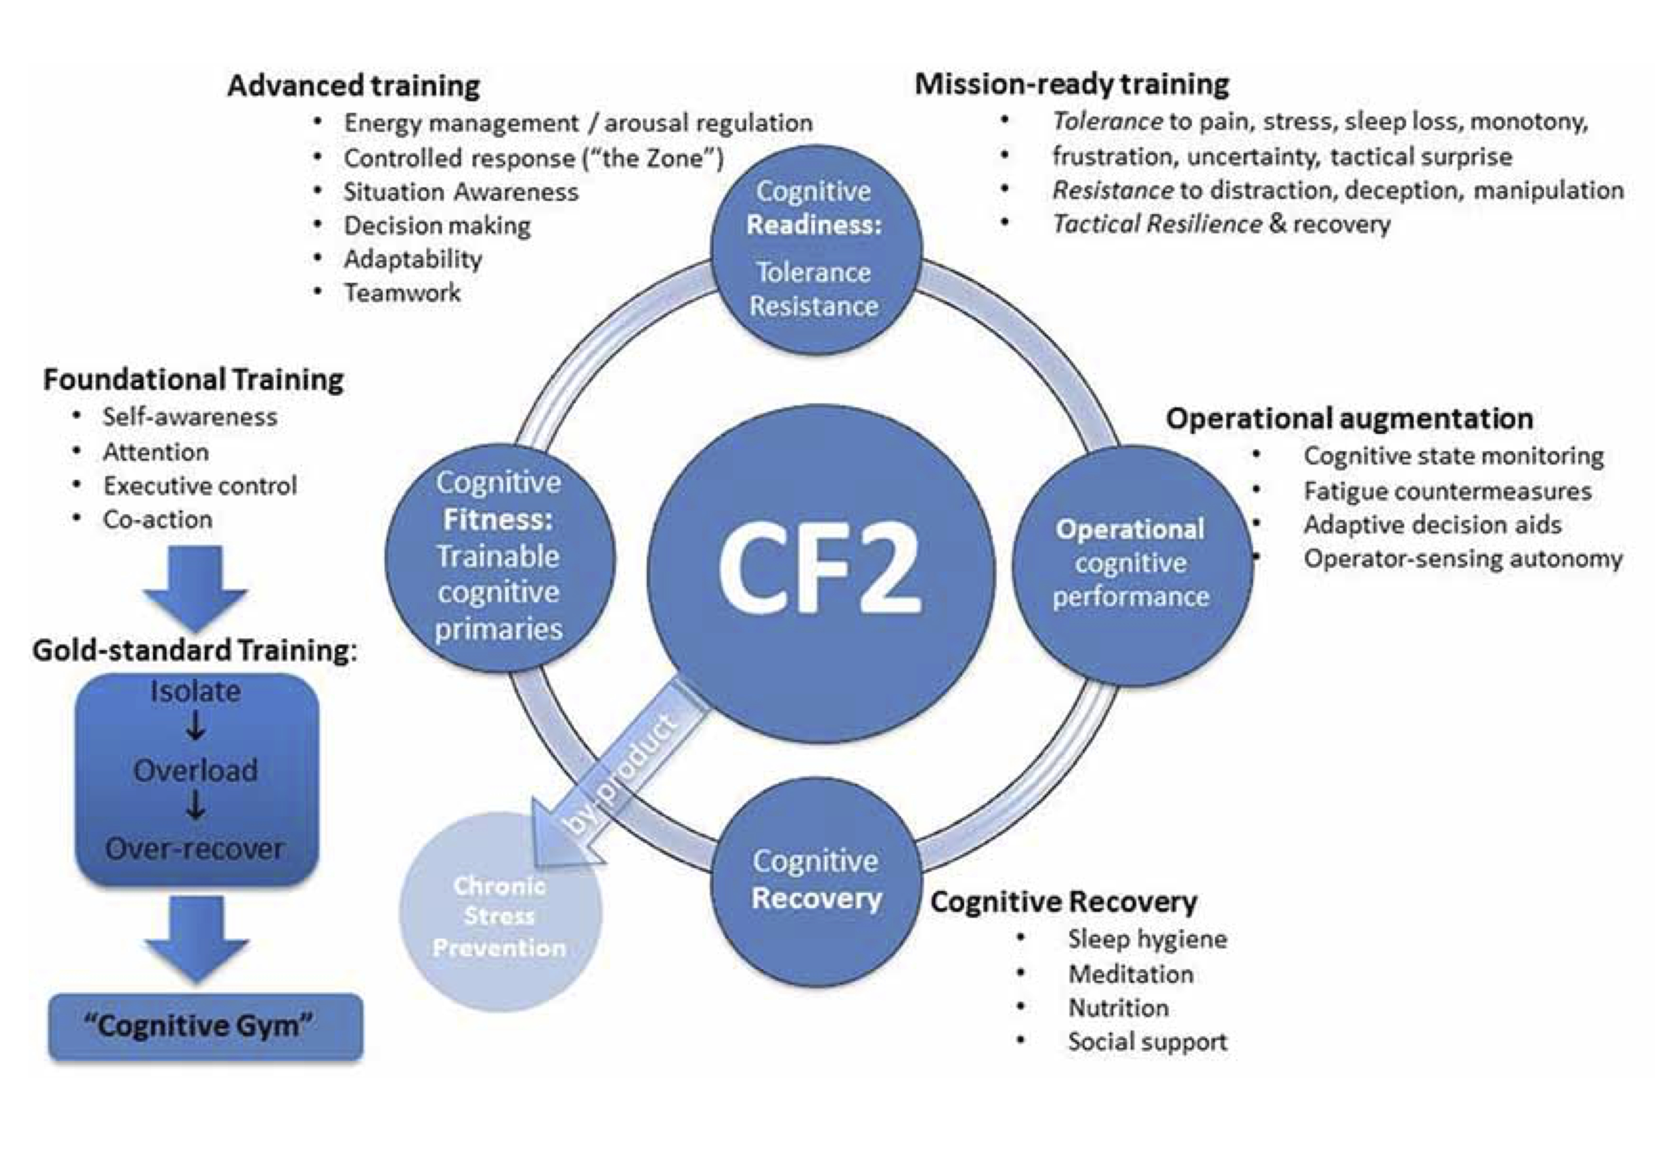
Defence Science & Technology Group (DST) has filtered these initiatives into the “Cognitive Fitness Framework” (CF2)
to guide the development of training programs, resources and facilities
Research
Initiatives
DST
The CF2 model is based around
the military “Deployment Cycle”
which mirrors a typical 4 year Olympic Cycle
in athlete development terms

Slide 4
The Cognitive Fitness Framework is applicable to a range of industries that depend on reliable high performance outcomes, and has gained a significant amount of interest from these industry groups
Research
Initiatives
DST
Military
Sport
Police &
Emergency
Performance
Arts
CF2 bridges the gap between performance psychology and mental heath support structures
Healthcare
Emergency Medicine
Nursing, Paramedics
Business
Education

Slide 5
The CF2 project is currently at the stage of seeking partners to complete the development of the protocols, training programs and associated resources for the various components to the standards required by Defence – directed by DST
Research
Initiatives
DST
Military
Sport
Police &
Emergency
Performance
Arts
Healthcare
Emergency Medicine
Nursing, Paramedics
Business
Education
Components
Protocols
Training Programs
Resources

Slide 6
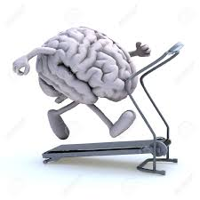
The CF2 modules complete the “Cognitive Gym” concept – a series of facilities to be built around the country that combines programs for the physical and cognitive preparation of Defence Personnel
Central to this project is the development of a CF2 App for additional training & support away from the Cognitive Gym
Research
Initiatives
Police &
Emergency
DST
Business
Performance
Arts
Education
Healthcare
Emergency Medicine
Nursing, Paramedics
Sport
Military
Components
Protocols
Training Programs
Resources
CF2 App
Story Board
Sequencing
Look & Feel Design
Scale-ability
Module Links
Roll Out
Cognitive Gym
Facility Design
Equipment
Protocols
Program Design
Data Collection

Slide 7
The CF2 collaboration between
CoSEP and the ARMY provides CoSEP with the opportunity to bring its collective expertise and experience to assist the development of training modules, the CF2 App, and in so doing the further development of the Cognitive Gym program
Nat ResearchCom
Research
Initiatives
Nat HiPerfCom
Fellows
AdvisoryCom
Team CoSEP
Students
Educators
Practitioners
DST
Business
CF2
Certification
Police &
Emergency
Performance
Arts
Education
Healthcare
Emergency Medicine
Nursing, Paramedics
Sport
CoSEP – DST
Collaboration
Military
Develop
Service
Potentials
Components
Protocols
Training Programs
Resources
CF2 App
Story Board
Sequencing
Look & Feel Design
Scale-ability
Module Links
Roll Out
Cognitive Gym
Facility Design
Equipment
Protocols
Program Design
Data Collection

Slide 8
Scope of Work as Identified by the Australian ARMY
1 - Develop CF2-informed instructional content for cognitive training / intervention to address the performance-related objectives of the Tokyo Games cohort affected by COVID-19
2 - Develop a pilot smartphone app to support the intervention
3 - Evaluate the effectiveness of the intervention
4 - Later, deliver the outcomes of this evaluation in a brief, peer-review publishable report
Caveats
1 - The project is conducted with the support, collaboration and oversight of DST
2 - The number of training modules and their configuration to be determined by CoSEP’s
subject matter expert practitioners
3 - The evaluation activity is developed by the SMEs in consultation with DST
4 - Ideally, the modules and the app are to be aligned with, and available later to be
trialled under Army’s Cognitive Gym construct
5 - The Commonwealth IP is acknowledged by all parties

Slide 9
Opportunity to engage CoSEP
members, students
Opportunity to make major contribution
to Australian ARMY, support
for their personnel
COVID Impact
On CoSEP Members
CoSEP Re-Positioning
Opportunity to align with
significant international
organisations
Project Drivers
Perceived relevance of APS
for CoSEP Members
CoSEP Assisting in relieving
the COVID Impact
on High Performance Sport Industry
Opportunity to influence
future directions of
Sport Psych profession
Tokyo Team
Protocol
Development
Professional
Sport
“Amateur”
Sport

Slide 10
Insight into impact that the COVID-19 disruption
has had on the Tokyo 2020 group, and the challenges
they face in the return to sport
Grief
Reaction
Restored
Intense
Focused
Driven
Anxious
Frustrated
Distracted
Deflated
Disappointed
Disbelieving
Cheated
Directionless
Unsure of Future
Self-Belief
Path/Career Clarity
Focused
Predictable Emotional Fluctuations
Recovery Targets
Olympic
Preparation
Olympic
Announcement
Immediate
Reaction/Effect
Program
Target
Burn Out
Recovery
Patience
Injuries
Rhythm Loss
Questioning
Anger
Rash decisions
Foolish, embarrassed
Empty
Self-worth, self-esteem
Stuck, can’t move on
Values & Ethics
Role Model
Own the Campaign
Risk Management Targets
Who is this person?
How far from ok / normal ops are they?
Have they started getting back on track?

Slide 11
Specific phase of COVID-19 recovery
where CF2 project will have maximum impact
Currently no systematic program exists
Grief
Reaction
Restored
Intense
Focused
Driven
Anxious
Frustrated
Distracted
Deflated
Disappointed
Disbelieving
Cheated
Directionless
Unsure of Future
Self-Belief
Path/Career Clarity
Focused
Predictable Emotional Fluctuations
Recovery Targets
Olympic
Preparation
Olympic
Announcement
Immediate
Reaction/Effect
Program
Target
Burn Out
Recovery
Patience
Injuries
Rhythm Loss
Questioning
Anger
Rash decisions
Foolish, embarrassed
Empty
Self-worth, self-esteem
Stuck, can’t move on
Values & Ethics
Role Model
Own the Campaign
Risk Management Targets
How are they coping?
Have they started to move on effectively?

Slide 12
Details
Sport / Event
Age / Years Competing
Career Status
Personal Status
College of
Sport &
Exercise
Psychologists
Risk Status
5
4
3
2
1
Emotional Control
Lifestyle Management
Focus
Interpersonal Style
Family Situation
Experience
Disbelief
Shock
Ripped Off
Extreme
Disappointment
Empty
Aimless
What a Waste
Oh, well
Had Been
Considering What Ifs
Could Have Happened
Go to Plan B
Financial
Next Career
Retirement
Study Program
Travel Plans
Relationships
Family Plans
Living Arrangements
Relocating
Injury Management
Technique / Equipment
Changes
High Expectation
Expected
To Do Well
Expected to
Maintain
Ranking
Not Expected
To Make Finals
No Performance
Expectations
Expecting
To Medal
Expecting to
Make Final
Expecting to be
Competitive
Was looking to
Learn lots / Gain Experience /
See What Could Do
No Expectations / Concerned
About How Competitive
Would Be
Great Lead Up
Everything Right
Good Lead Up
Things Working Well
Adequate / OK Lead Up
Had to Make Some
Adjustments
Disrupted Lead Up
Major Issues in
Final Preparation
Uncertain about Qualification
Been Very Challenging
High Profile
Recognizable
Team Member
(Hi Profile)
Team Member
(Lo Profile)
Unknown
Public Expectations
Personal Expectations
Lead Up Preparations
Reaction When Decision Announced
Implications & Realities
Current Emotional State
Blaming
Unstable
Frustrated
Disbelieving
Recommendations
Moody
Angry
Depressed
Irritable
Professional Assistance Required
Networks
Monitor
Intervene
Refer
Work / Performance
Social / Family

Slide 13
Opportunity to engage
other Colleges
Addressing
COVID Impact
on Members
Additional income source
with minimal resource impact
Opportunity to align with
significant international
organisations
Potential
Opportunities
For
APS
Opportunity to position APS
as supporting initiatives
for Members
Opportunity to demonstrate APS
active involvement / leadership
in COVID-19 recovery
Public Relations Opportunities
Opportunity to develop
Specific themes for APS Conferences,
certification projects

Slide 14
Opportunity to engage and
Integrate CoSEP
members, students
“Team CoSEP”
Provide potential income source
For members impacted
By COVID disruptions
Potential to rejuvenate
Industry & perceptions of
Value of College, APS
Opportunity to align with
significant national
& international organisations
Potential
Opportunities
for
CoSEP
Opportunity to position APS
& CoSEP as supporting initiatives
for Members
Position CoSEP as
Significant industry leader
Public Relations Opportunities
Including repositioning Sport Psych
In high perf sport industry
& in public eyes
Focus for Continuing
Professional Development
Not just a
“soft science”
Program Review
System

Slide 15
APS Protocols
& Management Principles
Contemporary
Requirements
Of Def Projects
Budgetary Control
Possibility of project
continuing into subsequent years
CoSEP
Members
Experience
Project
Management
Additional income source
with minimal resource impact
Potential
Risks
for
APS
Associated organisations
united in development
of CF2 objectives
Opportunity to position APS
as supporting initiatives
for Members
Alignment of objectives, operating
principles with ARMY and
associated international
organisations
View of other
Sub-groups, Colleges
Opportunity to influence
future directions of profession
APS is recognised as
a provider to Australian ARMY
Empowering Colleges
In AOPE Review Input
“Point of Difference”

